Slide 1
An Urban Truck Scheduling and Routing Problem
By Zeyu Liu, Zefeng Lv, Rui Zhou

Slide 2
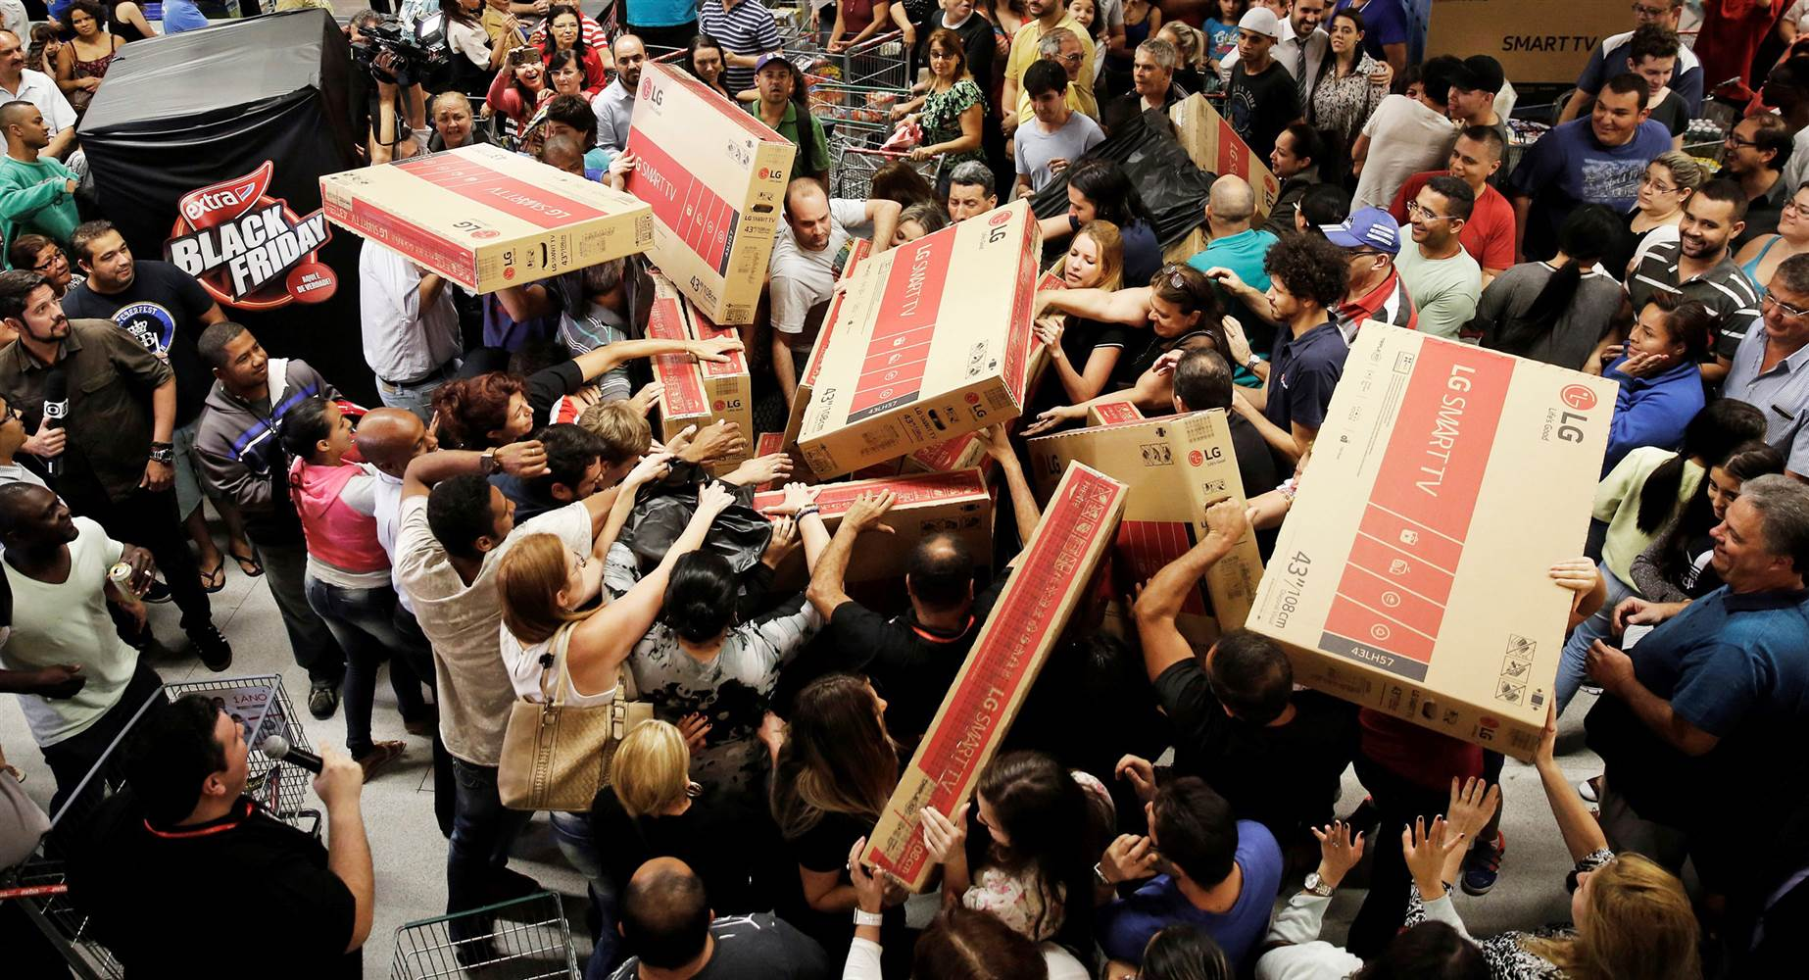

Slide 3

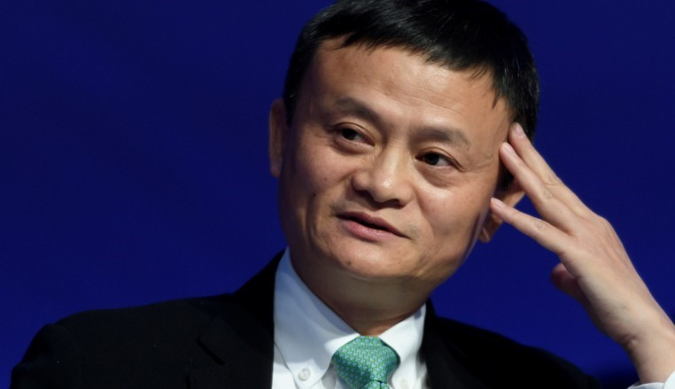

Slide 4
Double Eleven Shopping Festival
10 billion yuan in 125 seconds ($ 1.4 billion)
213.5 billion yuan in 24 hours ($ 30.5 billion)
812 million goods
2 - 7 days (no shipping fee)
1 - 2 days ($ 2)

Slide 5

Jing Dong
Better quality
Better logistics (next day delivery)

Slide 6
What’s our problem?
One distribution center
More than 1000 customers
Decisions
How many trucks?
What’s the route?

Slide 7
Objective function
Minimize the total cost: fixed cost, traveling cost, waiting cost
Constraints
Driving range
Weight and volume capacity
Time window
Others: Recharge, multi-trips, heterogeneous fleet.

Slide 8
Data sample
Node ID | Longitude | Latitude | Package Weight (tons) | Package Volume (cubic meters) | Earliest Time | Latest Time
1 | 116.242043 | 40.072630 | 0.20760 | 0.3666 | 09:00 | 12:00
2 | 116.403595 | 39.872945 | 0.05863 | 0.1687 | 13:30 | 14:00
3 | 116.186289 | 40.016361 | 0.03645 | 0.0745 | 13:00 | 15:00
4 | 116.508011 | 39.826296 | 0.02595 | 0.0542 | 09:00 | 10:00
5 | 116.130997 | 39.825921 | 0.0198 | 0.1117 | 11:00 | 13:30
… | … | … | … | … | … | …
50 | 116.214509 | 40.122890 | 0.01697 | 0.0260 | 11:00 | 12:00

Slide 9
Data sample
From Node | To Node | Distance (kilometers) | Transport Time (minutes)
0 | 1 | 63536 | 77
0 | 2 | 27489 | 33
0 | 3 | 62041 | 75
0 | 4 | 13365 | 17
0 | 5 | 45570 | 55
… | … | … | …

Slide 10
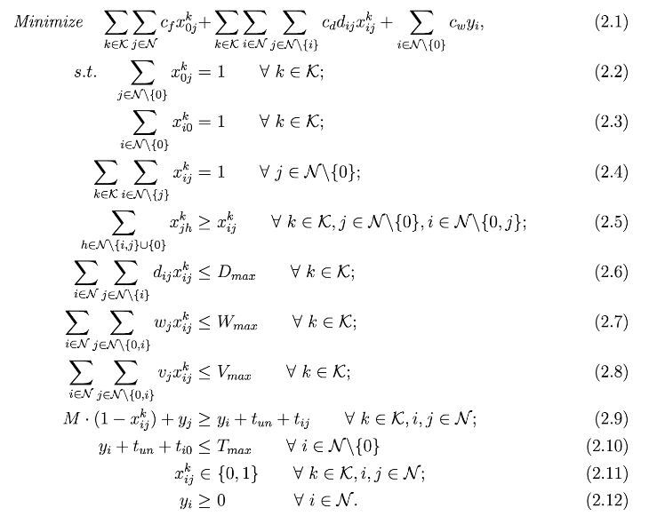
Mathematic model

Slide 11

Complexity
Consider a smaller problem, with 50 customer locations;
Number of decision variables = ${51}^{2}−51$=$2550$;
Binary combinations = $2^{2550}$.

Slide 12

Why not AnyLogic
Optimization iterations:
No more than 500 for Personal Learning Edition;
Compared to $2^{2550}$ combinations;

Slide 13
To simplify
Sampling data;
Using another solver.

Slide 14
Sampling
R (version 3.5.1);
Taking 50 customer locations:
with corresponding “distance”, “travel time”, etc.
R Code

Slide 15
Solving
Cplex (version 12.8)
with Python (version 3.6.5) API;
Python Code:
Main;
Model.

Slide 16
Solutions
Solution File

Slide 17
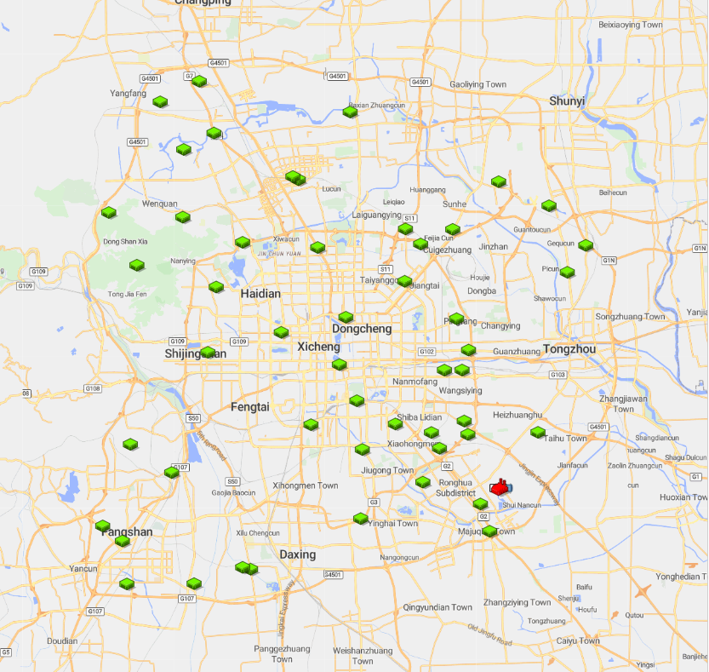
Anylogic Model
GIS MAP
1.Import database
2.Locate distributor and customers

Slide 18
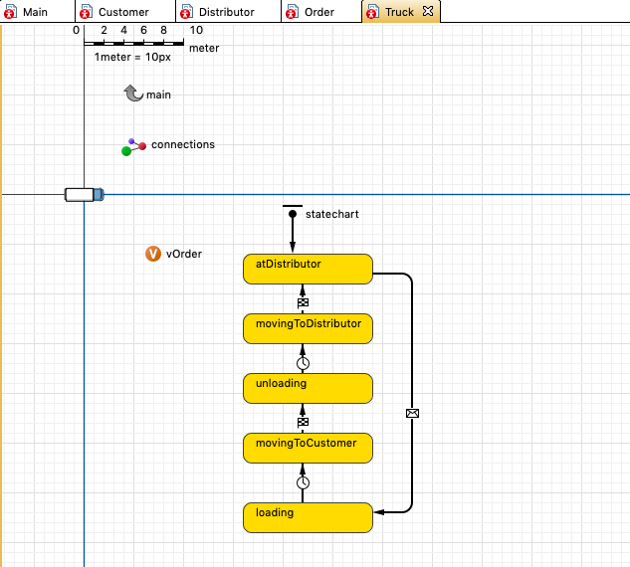
Truck

Slide 19
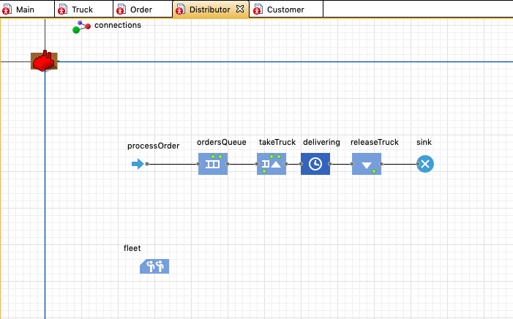
Distributor

Slide 20
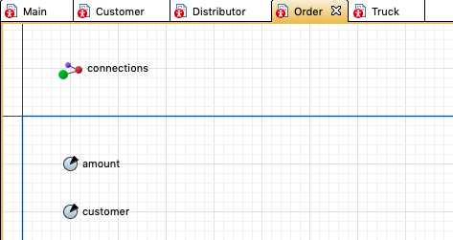
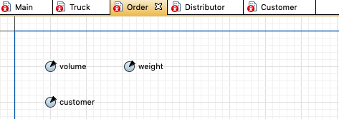
Order

Slide 21
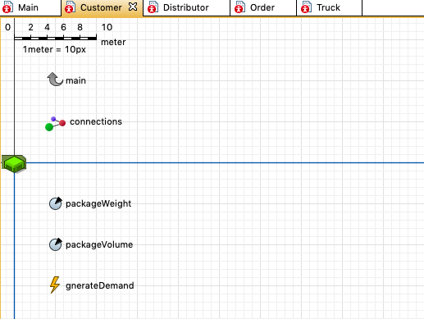
Customer

Slide 22
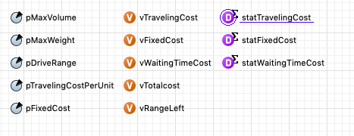
Variables

Slide 23
Future to Do
Import optimal route into AnyLogic
Get minimize total cost
Take more constraints into consideration

